Slide 1


Chief Eric J. Guenther
Mundelein Police Department

Slide 2

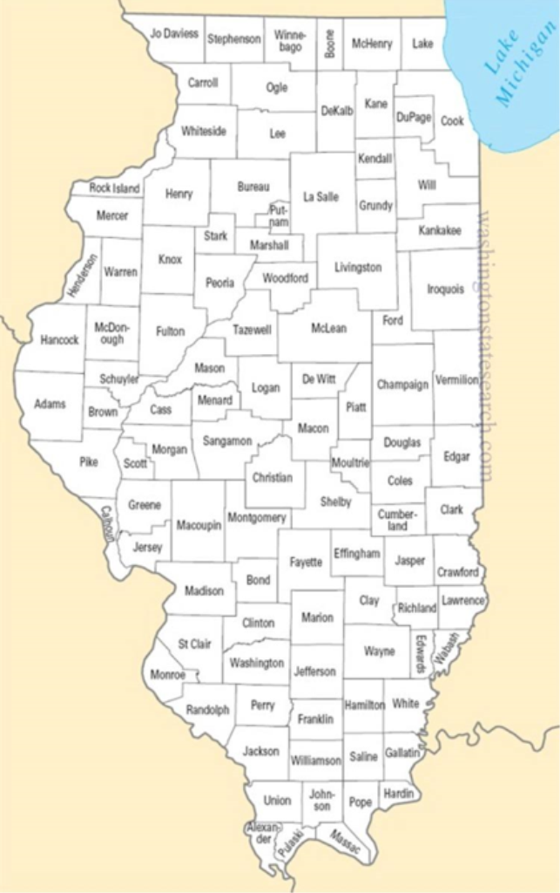
The A Way Out Program was launched on June 1, 2016 from the Lake County Opioid Initiative, a county wide Task Force which began in 2012 in Lake County Illinois. The Program was modeled after the Angel Program in Gloucester, Massachusetts

Slide 3
A Way Out
A Way Out - is a county-wide Law Enforcement Assisted Diversion Program, designed to fast-track users to substance abuse programs and services.
Available 24 Hours a Day, 7 Days a Week, 365 Days a Year
Participants will NOT be charged for possession of narcotics or paraphernalia as long as participant voluntarily presents to police station or officer for assistance.

Slide 4
Partners in the A Way Out Program
Lake State’s Attorney’s Office
Antioch Police Department
Deerfield Police Department
Grayslake Police Department
Gurnee Police Department
Lake County Sheriffs Department
Libertyville Police Department
Mundelein Police Department
Lake Forest Police Department
Round Lake Beach Police Department
Round Lake Park Police Department
Zion Police Department
Lake County Health Department
NICASA
Lake County Probation
Lake County Bar Association
Lake County Judges
12 Step Community
Advocate Condell Hospital
Advocate Good Shepard
Northwestern Memorial Health Care (Lake Forest/Grayslake)
Vista Health
Live4Lali
Gateway Foundation
Soft Landing Recovery
Rosecrance
Omni Youth Services
Brightside Clinics

Slide 5
Program Documents
Memorandum of Understanding Between Partners
http://police.mundelein.org/sites/default/files/shared-files/A_Way_Out_MOU.pdf
Program Participant Waiver
http://police.mundelein.org/sites/default/files/shared-files/A_Way_Out_Waiver.pdf
Brief Screening Tool-conducted via phone
http://police.mundelein.org/sites/default/files/shared-files/A_Way_Out_screening_tool.pdf

Slide 6
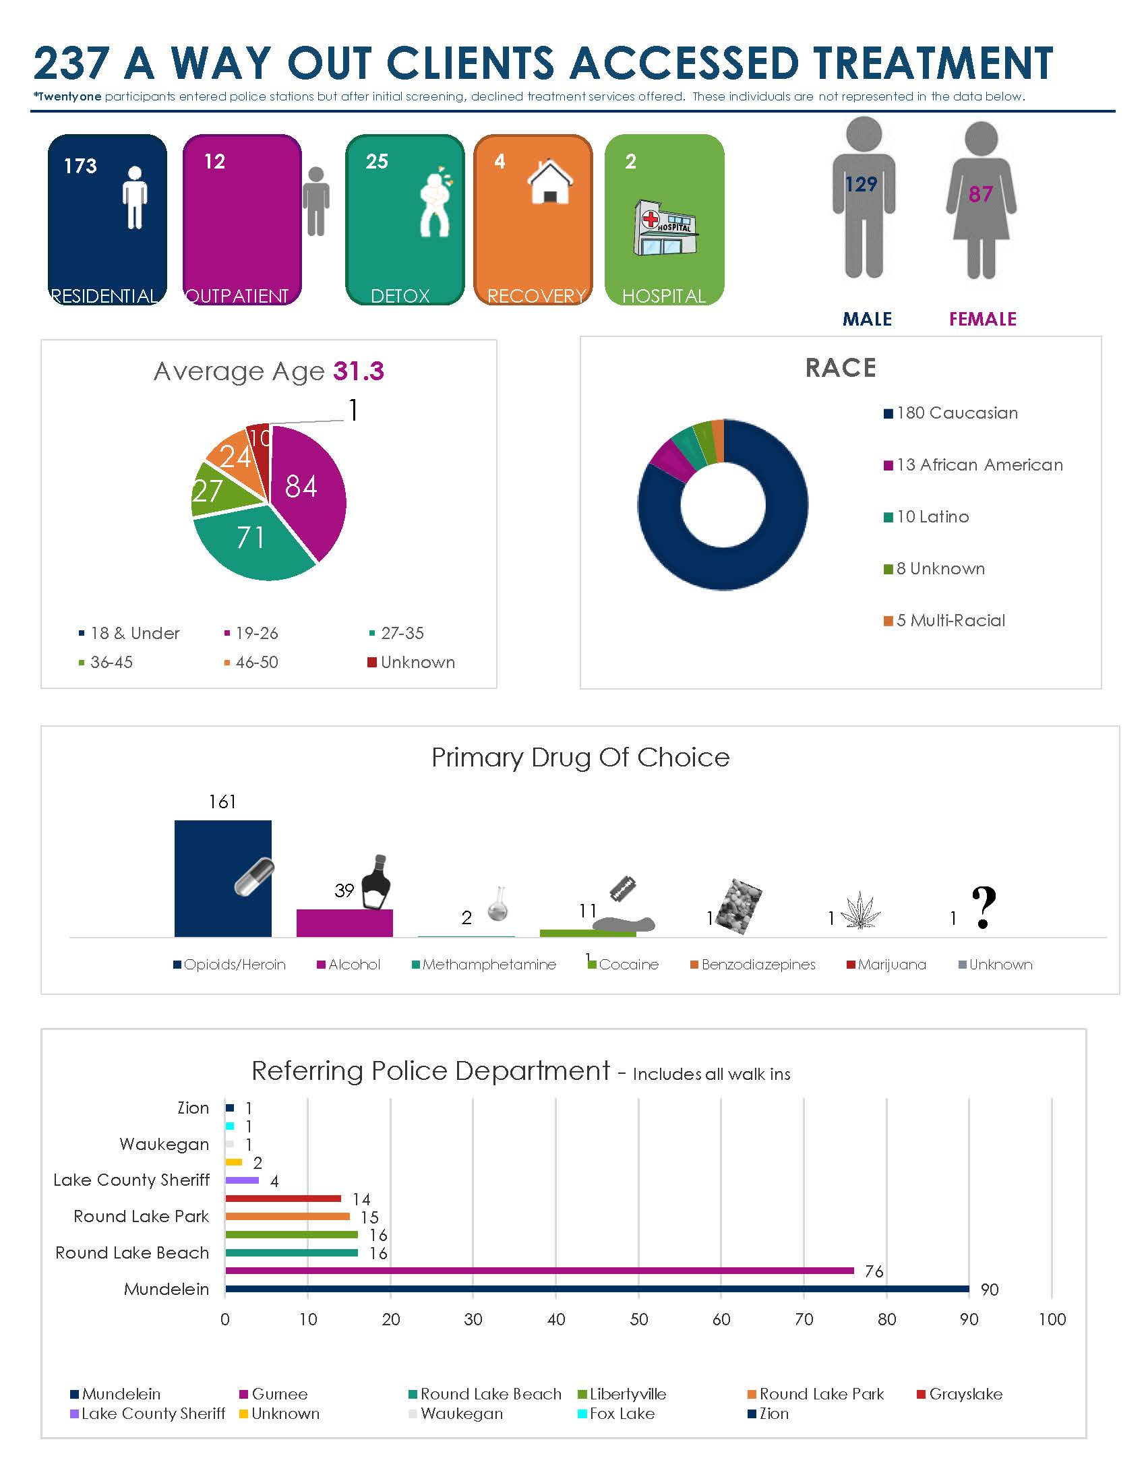
Participant Information Year 1

Slide 7
Pre-arrest Diversion
Pre Arrest Diversion – the concept of diverting eligible individuals away from criminal justice systems and into behavioral health interventions.
Use these models with substance use and / or mental health.
Reduces crime and recidivism.
Half of violent crime offenders and theft of property offenders say they committed crimes while under the influence.
Improves community / law enforcement relations.
Reduces burden on the justice system.
About 80,000 Americans are incarcerated for Opioid related crimes alone.
Restores lives / families
Reduces costs
Every dollar spent on treatment, saves up to three dollars in crime reduction.

Slide 8

Program Evaluation
Rosalind Franklin University
Community assessment of officers and community stakeholders.
Participant initial assessment, and longitudinal assessment of participant outcomes over one year after program entry.

Slide 9
Questions?
Eric J. Guenther, Chief of Police
Mundelein Police Department
Mundelein, Illinois
847-968-3775
eguenther@Mundelein.org

